Slide 1
Integrating MBSE with High-Fidelity Crash Simulation
Patrick J. Rye, D.Eng
General Motors / Colorado State University
Notes:
Welcome — thank the session chair and the audience.
Introduce yourself: Propulsion VPIM at GM and doctoral candidate at Colorado State in Systems Engineering.
Frame the talk: electrification has outpaced our ability to trace safety requirements between system models and high-fidelity crash analysis. This paper proposes an open framework to close that gap.
Mention the 15-minute time budget and that you'll cover the problem, the four-layer architecture, an EV side-pole case study, and the traceability gains versus document-based engineering.

Slide 2
The Problem: EVs Demand Multi-Domain Safety Certification
High fidelity crash simulation: are critical engineering methodologies not currently well connected to safety requirements systems engineering processes
                DBSE: requirement and design intent are captured in separate artifacts, which in complex ground vehicle systems can complicate requirement traceability [Banik & Sengupta, 2024]
                MBSE: design intent and requirements are captured in SysML but are disconnected from high-fidelity analysis [Madni & Sievers, 2018; Carroll & Malins, 2016]
EV complexity: battery thermal management adds a critical new failure mode after crash.
  Because high fidelity simulations focus on one domain simulations (structural, or thermal) multiple simulations are required to fully verify requirements [Cheng et al., 2025; Hemakumar et al., 2024]
Thermal runaway risk: partially crushed coolant lines could cause cells to overheat
Current gap: systems engineers cannot verify crash-driven thermal risk directly from the SysML model
Need: a continuous digital thread from requirement → simulation → verified result
Notes:
Set the stakes: EVs introduce post-crash thermal runaway as a hazard that occupant-safety regulations don't directly address.
Explain why DBSE struggles: requirements live in disconnected documents, RTMs are updated by hand, and a localized design change can silently violate a system-level safety constraint.
Read the research question aloud and let it sit for a beat — this is the spine of the talk.
Land the NDIA hook: the same problem applies to Army GVSC, USMC THEVs, and the DoD Digital Engineering mandate. Your framework is directly applicable.

Slide 3
The Fidelity Gap: MBSE Describes, CAE Verifies
MBSE (SysML/RAAML): captures hazards, UCAs, requirements, topological and descriptive [Borky & Bradley, 2019; Madni & Sievers, 2018]
High-fidelity FEA (LS-Dyna) can capture the results but outputs raw binary d3plot files inaccessible to SysML [Busch et al., 2026; Zeigler et al., 2018]
Four identified gaps in literature [Nigischer et al., 2021; Castellano, 2025; Sarathi & Martinez, 2025]:
Gap 1 — Manual parameter instantiation: SysML → LS-Dyna deck still done by hand
Gap 2 — Static data linkages: no live V&V feedback from simulation to SysML
Gap 3 — Semantic disconnect: SysML cannot automatically receive LS-Dyna results
Gap 4 — Data management: MBSE tools cannot host terabytes of crash simulation output
Notes:
Explain the fidelity gap in one sentence: MBSE knows *what* a component is, CAE knows *how* it deforms — and they don't talk to each other.
Walk through the four literature gaps quickly: manual parameter mapping, static SysML, no automated risk feedback, and binary-output data management.
Anchor on the binary-output point — FMI/SysPhS were designed for 1D co-simulation, not the hundreds of gigabytes that non-linear 3D FEA produces.
Transition: 'These four gaps define what a credible framework has to solve.'

Slide 4
Five Framework Requirements
R1 — Standardized Safety & Risk Ontologies: RAAML / ISO 26262 stereotypes establish auditable trace links (mitigates, causedBy, verifies) between crash hazards, requirements, and the vehicle architecture [OMG RAAML, 2022].
R2 — Formalized Simulation Context via Simulation Blocks: 《SimulationRequest》 block captures boundary conditions, target variables, solver/HPC metadata, and material references. Making each run reproducible and auditable [Sohier et al., 2021].
R3 — API-Driven Data Interoperability: OSLC and SysML APIs replace static document exports, pushing 0D/1D system properties directly into FE input deck variables.
R4 — Data management with SDM: MBSE holds a lightweight semantic link to the SDM record; binary result files (binout, d3plot) live in the SDM, preserving single-source-of-truth without overwhelming the system model.
R5 — Automated V&V Feedback Loop: KPIs extracted from FEA output files are pushed back to MBSE, auto-flagging Pass/Fail and propagating failure state to upstream risk analyses.
These five requirements directly motivate the four-layer reference architecture proposed next.
Notes:
These five requirements derive directly from the four gaps and motivate the architecture you just saw.
Don't read all five — highlight R1 (ontologies make trace links auditable), R3 (API-driven parameter mapping eliminates manual deck editing), and R5 (automated V&V feedback closes the loop).
Mention that R4 — SDM integration — is what makes this scalable to real production model sizes.
Transition: 'Now let me show how these requirements play out on a concrete EV case study.'

Slide 5
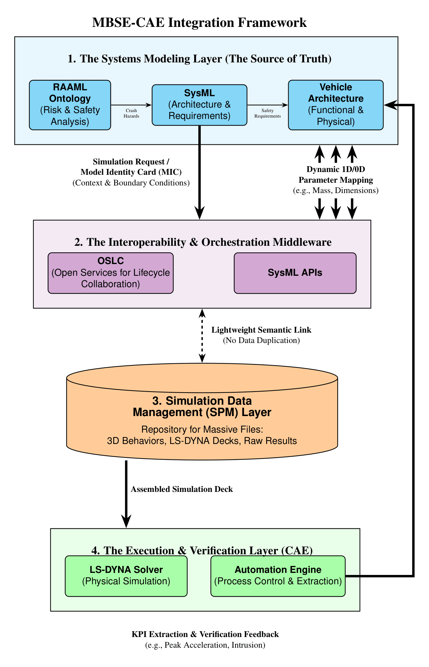
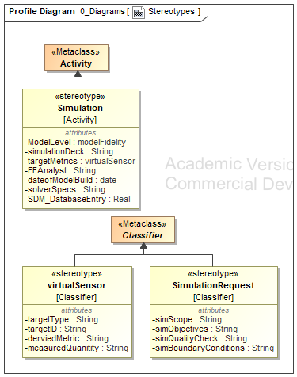
Proposed Architecture: Four-Layer Hub-and-Spoke
Layer 1 — Descriptive (SysML / RAAML / STPA): hazard analysis, UCAs, requirements, block diagrams
Layer 2 — Interoperability Middleware (Python binder + OSLC REST API): extracts SysML parameters, generates LS-Dyna input decks, pushes results back to SysML blocks
Layer 3 — Simulation Data Management (SQLite + UUID-keyed records): stores simulation inputs, outputs, and V&V status; preserves full audit trail
Layer 4 — Execution & Verification (LS-Dyna HPC, MSOSA): runs FEA on HPC; auto-evaluates pass/fail against SysML-defined thresholds; flags MSOSA requirement status
Hub: Software binder orchestrates all cross-layer data flows. For the case study python was used, but any language that enables query/output into SysML would work
Notes:
Introduce the four-layer hub-and-spoke architecture. Take 90 seconds here — this is the centerpiece.
Layer 1 (Descriptive): SysML extended with RAAML stereotypes; this is where hazards, requirements, and SimulationRequest blocks live.
Layer 2 (Middleware): the Python binder using OSLC and SysML APIs — replaces fragile file exports with live parameter mapping.
Layer 3 (SDM): keeps the binary result files out of the MBSE database; MBSE holds a lightweight pointer.
Layer 4 (Execution & Verification): LS-DYNA on HPC, with KPIs pushed back to the system model.
Emphasize: this is open, vendor-agnostic, and auditable — contrast with proprietary Teamcenter/3DEXPERIENCE stacks.

Slide 6
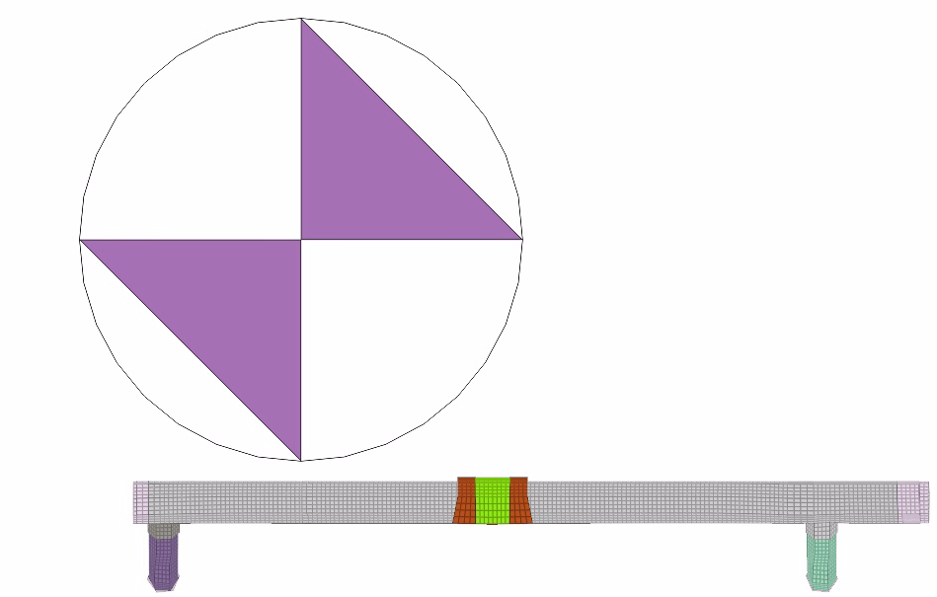
Case Study: EV Battery Thermal Management System (BTMS)
Vehicle scenario: EV side-pole subsystem impact (FMVSS 214 / Euro NCAP small overlap analog)
Structural target: aluminum coolant pipe (6063-T5 alloy) routed adjacent to battery module
Hazard: if pipe is partially crushed, restricted coolant flow → thermal runaway; ECU detects no fault until temperature threshold reached
LS-Dyna model: 127 mm rigid pole, impact velocity 0.7 m/s, 192 HPC cores, ~90 sec/run
Failure criterion: max plastic strain > 17%
        Secondary Analysis: Plastic strain < 17%, measure area loss and run 1D thermal simulation
Parameter under study: pipe wall thickness (0.8 mm nominal)
Notes:
Critical caveat: this is a *process demonstration*, not a certified crash analysis. The models are intentionally simplified to exercise every layer of the pipeline.
Describe the setup: aluminum coolant pipe (6063-T5), routed next to the battery module, struck by a rigid pole at 0.7 m/s.
State the failure criterion clearly: max plastic strain above 17.1% triggers structural failure. That number comes from Barsoum's published work on extruded 6063-T5 tubes.
The parameter under study is wall thickness, swept from 0.2 to 1.0 mm.

Slide 7
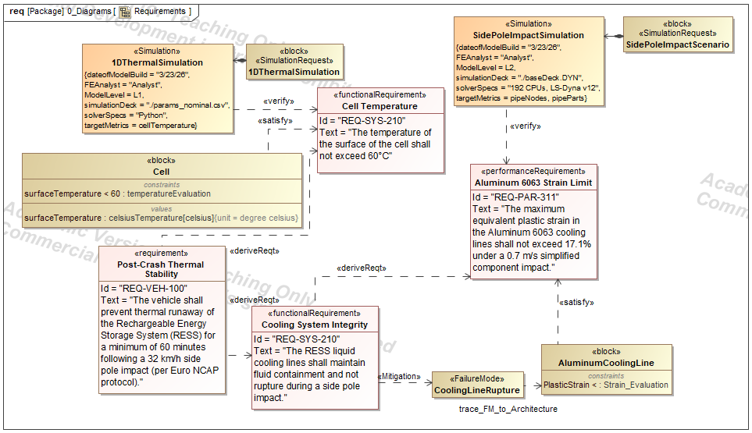
STPA Safety Analysis: Identifying the Critical Hazard
System: Battery Thermal Management System (BTMS) control action: "provide coolant flow" — modeled via RAAML stereotypes Four Unsafe Control Actions (UCAs):
UCA-1: ECU provides cooling flow at normal rate when pipe is ruptured → pressurizes ruptured system
UCA-2: ECU stops cooling when pipe is partially blocked → thermal runaway from reduced flow
UCA-3: ECU provides cooling after full pipe crush → no benefit, delays thermal response
UCA-4: ECU does not detect partial restriction → no fault flag → runaway develops silently ← PRIMARY HAZARD
UCA-4 drives the simulation requirement: verify pipe maintains cross-sectional area sufficient for minimum flow
Notes:
Use STPA to show *why* flow area is the right surrogate metric.
Walk the audience through the control loop: BTMS ECU commands the pump, gets pressure feedback. A partially crushed line reduces flow area without dropping pressure below the sensor's detection threshold.
UCA-1 (continued pumping through a restricted line) plus UCA-2 (no shutoff because feedback looks nominal) is the worst-case combination — silent thermal degradation while the ECU reports 'no fault.'
This is why we extract post-crash cross-sectional area from LS-DYNA: it's the variable the ECU can't see.

Slide 8
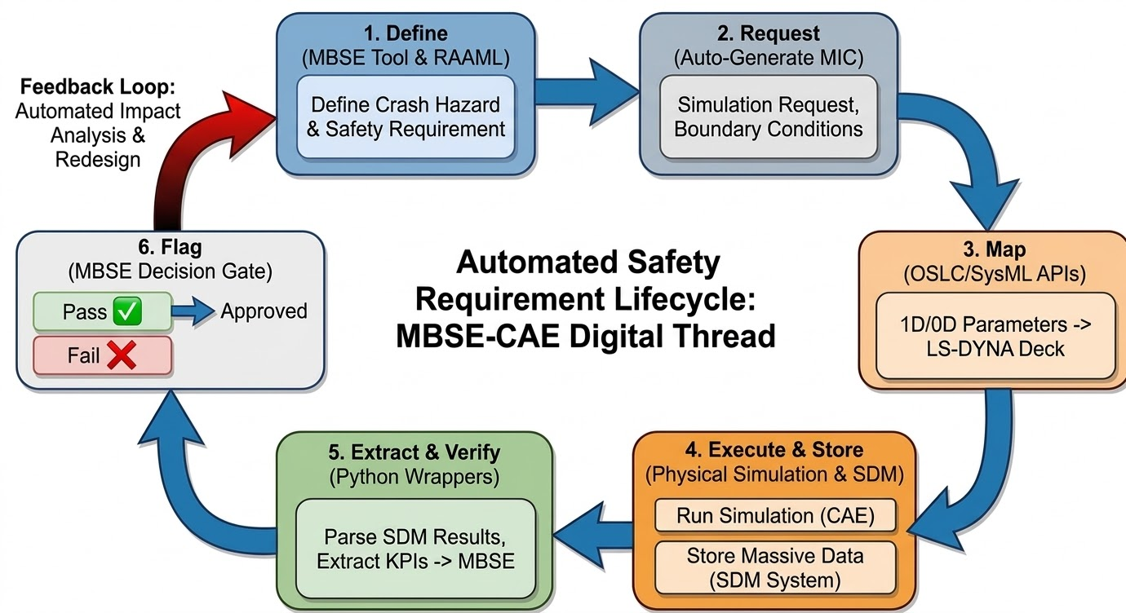
The Digital Thread: Six-Step Automated Cycle
Step 1 — Define: STPA/RAAML model captures hazard; <<SimulationRequest>> block created in SysML
Step 2 — Request: Python binder queries SysML model via OSLC REST API; extracts wall_thickness, material, boundary conditions and submits to Modeler who creates the LS-Dyna deck
Step 3 — Map: Python auto-generates LS-Dyna .k deck from SysML parameter values — zero manual editing
Step 4 — Execute & Store: LS-Dyna runs on 192-core HPC (90.4 ± 4.5 s/run); results UUID-keyed and stored in SQLite SDM layer
Step 5 — Extract & Verify: Python post-processor reads d3plot binary; extracts max plastic strain and pipe area (21.6 ± 3.5 s); evaluates against SysML thresholds
Step 6 — Flag: V&V result written back to SysML <<VerificationResult>> block; MSOSA requirement status set Pass/Fail
Notes:
Walk the six steps in order. Spend ~10 seconds per step.
Step 1: hazard and requirement defined in RAAML. Step 2: SimulationRequest block created. Step 3: Python binder maps parameters into the LS-DYNA deck via OSLC.
Step 4: LS-DYNA runs on HPC, raw results go to SDM. Step 5: Python post-processor extracts the KPIs from the d3plot. Step 6: SysML auto-flags pass/fail.
Emphasize that the entire cycle is closed — no human in the middle moving data between tools.

Slide 9
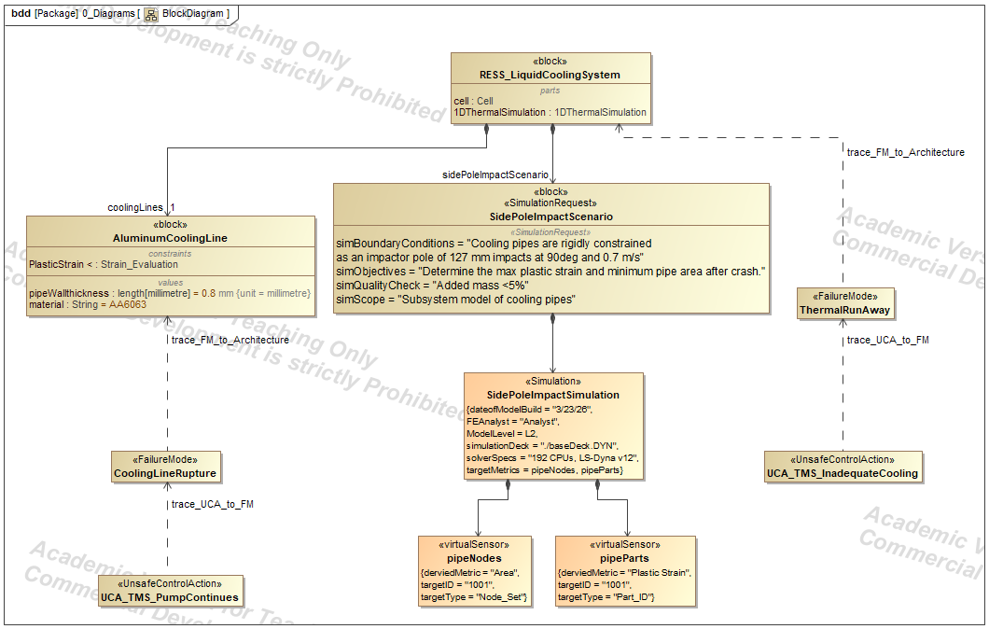
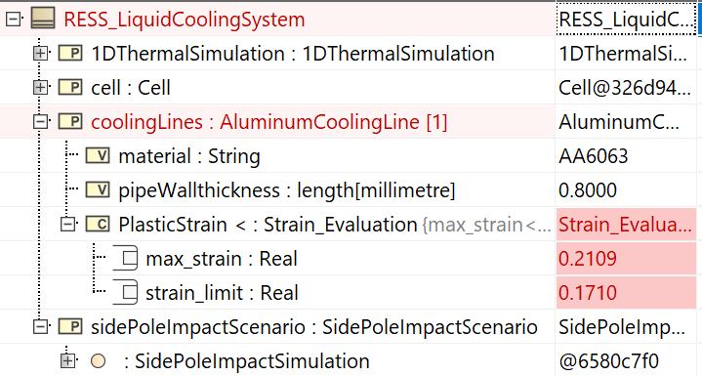
Results: Baseline Run — Automated Failure Detection
Baseline configuration: 0.8 mm wall thickness (nominal design)
Max plastic strain: 21.1% — EXCEEDS failure threshold of 17%
Pipe cross-sectional area at final time step: 107.3 mm²
MSOSA automatically flags Requirement REQ-BTMS-001 as RED
No manual post-processing required — result available 22 seconds after LS-Dyna completes
Finding: the nominal pipe wall thickness is structurally inadequate for this impact scenario
Notes:
Baseline configuration is the nominal 0.8 mm wall.
Max plastic strain comes back at 21.1% — exceeds the 17.1% threshold.
MSOSA automatically flags the requirement as failed. No manual post-processing, no spreadsheet handoff.
This is the moment that proves the loop closure works. Pause briefly on the MSOSA screenshot.
Lead-in to the next slide: 'So the nominal design fails. What does the framework let us do next?'

Slide 10
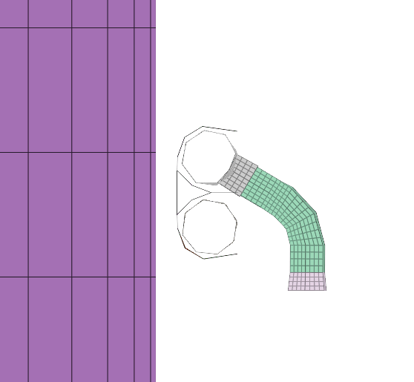
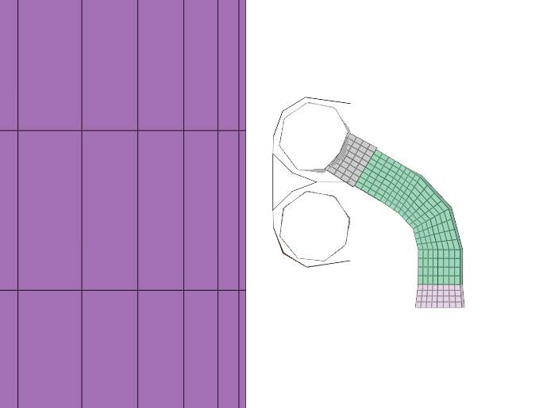
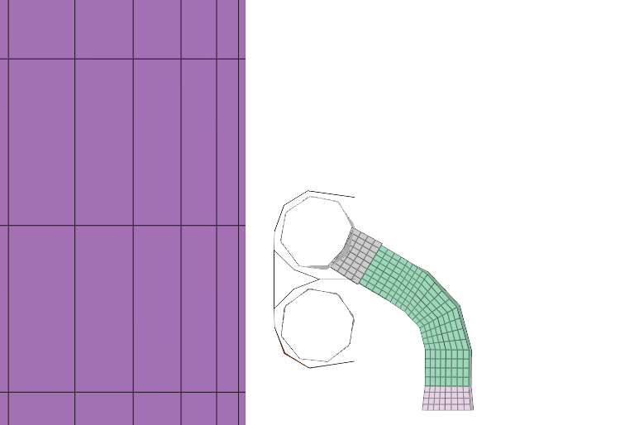
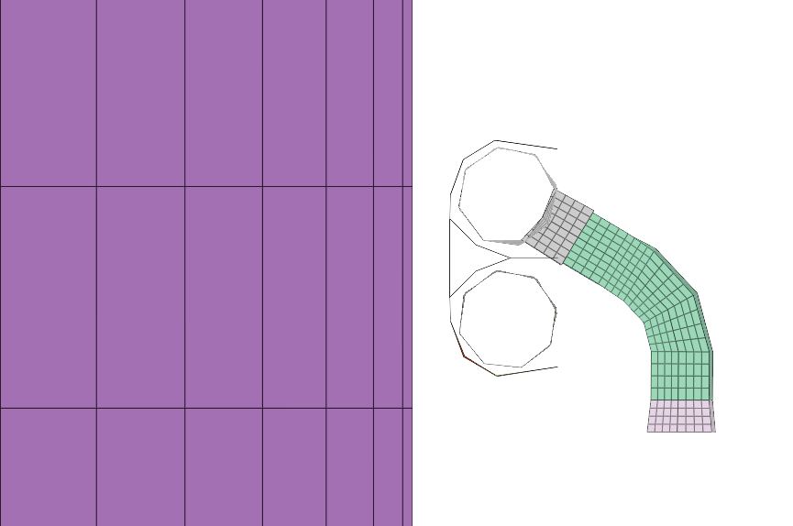
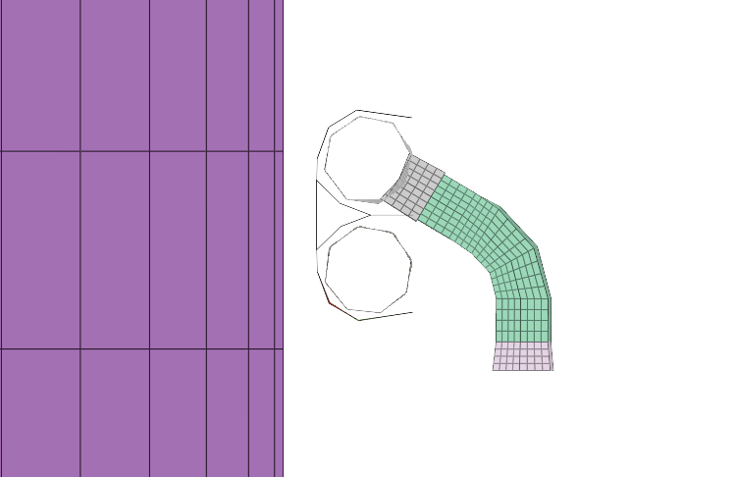
Parameter Sweep: Finding the Safe Design Point
Five wall thicknesses evaluated; all runs automated through the digital thread
Counterintuitive result: intermediate wall thickness (0.4 mm) optimizes both structural integrity and flow retention — thinner walls distribute strain via global ovalization rather than localized hinging [Wierzbicki & Suh, 1988].
Wall (mm) | Max plastic strain | Final pipe area (mm²) | Cell temp (°C) | Result
0.2 | 13.9% ✓ | 68.0 | 73.8 ✗ | FAIL — temp exceeds 70 °C
0.4 | 15.0% ✓ | 94.9 | 63.3 ✓ | PASS ← OPTIMAL
0.6 | 18.2% ✗ | — | — | FAIL — structural failed, thermal not evaluated
0.8 | 21.1% ✗ | — | — | FAIL — baseline configuration
1.0 | 23.0% ✗ | — | — | FAIL — thicker wall fails sooner (less deformation absorbed)
0.2 mm
0.4 mm
0.6 mm
0.8 mm
1.0 mm
Notes:
Five wall thicknesses, all run automatically through the digital thread.
Walk the table left to right, then highlight the green row: 0.4 mm is the only configuration that passes both strain and temperature requirements.
Call out the counterintuitive result: thicker walls (0.6, 0.8, 1.0 mm) fail sooner. This is because bending stiffness scales with thickness cubed — thinner walls distribute the impact energy through global ovalization instead of localizing plastic strain.
But ovalization has a cost — the pipe stays restricted, so flow drops. That's why 0.2 mm passes strain but fails the thermal requirement.
Main message: this trade-off between competing physics constraints is exactly what non-linear CAE captures, and what the framework now makes traceable.

Slide 11
Traceability: DBSE vs. Digital Thread
Document-Based Systems Engineering (DBSE) baseline:
Scenario: late-stage cell-chemistry update drops thermal runaway threshold from 70°C to 60°C — does the 0.4 mm design still comply?
Active engineering time per run: ~15 minutes (manual parameter extraction, deck editing, results transcription)
Manual data handoffs: 4 (SysML → Word → LS-Dyna → spreadsheet → report)
Traceability: search across 3 separate documents; no semantic link
Risk: high transcription error probability
Proposed Digital Thread:
Active engineering time per run: 0.54 s (SysML extraction) + 21.6 s (post-processing) = ~22 s total
Manual data handoffs: 0 (fully automated)
Traceability: 1 automated semantic link from requirement to simulation record
Risk: zero transcription error
Speed improvement: ~40x reduction in active engineering time per simulation configuration
Traceability hops reduced 75% (4 → 1); orphaned-requirement risk fully eliminated — impact assessment goes from hours to seconds.
Notes:
This is the punchline of the talk — slow down here.
Use the late-stage change scenario: imagine the cell chemistry update drops the thermal runaway threshold from 70 °C to 60 °C. Does the 0.4 mm design still comply?
In DBSE: 4 manual handoffs, hours of search across documents, real risk of an orphaned requirement.
In the proposed framework: single SysML parameter update, the stored KPI is re-evaluated instantly, the failure propagates through the RAAML links to the originating UCA.
Headline numbers: ~40× faster active engineering time, 4 → 0 manual handoffs, 75% reduction in traceability hops, orphaned-requirement risk eliminated.

Slide 12
Orchestration Performance: Python Binder Timing
SysML parameter extraction via OSLC REST API: 0.54 ± 0.12 s (10 runs)
LS-Dyna .k deck generation: included in 0.54 s (negligible)
LS-Dyna execution: 90.4 ± 4.5 s (192-core HPC; scales linearly with model complexity)
Post-processing (d3plot extraction): 21.63 ± 3.5 s
d3plot binary load: 21.55 s (dominant — LS-Dyna file I/O bottleneck)
Max plastic strain extraction: < 0.01 s
Pipe area calculation: < 0.02 s
1D thermal model: < 0.02 s
Total active engineering time per run: ~22 s (vs. ~15 min DBSE manual process)
Bottleneck is LS-Dyna I/O — not the orchestration layer; amenable to parallelization
Notes:
Show that the orchestration layer itself is fast.
SysML extraction is half a second. Post-processing is ~22 seconds, dominated by loading the d3plot into memory (21.5 s).
LS-DYNA itself takes ~90 seconds on 192 cores — that's the solver, not our overhead.
Conclusion: the bottleneck is I/O, not the framework. As LS-DYNA's parallel I/O improves, the orchestration scales with it.
If pressed for time, skip this slide — it's a backup for skeptics on overhead.

Slide 13
Limitations & Future Work
Current limitations:
Deterministic only: single simulation per configuration; no stochastic uncertainty quantification
Subsystem Demonstration: FEA model was small, scalability on full vehicle models needed
Parametric changes only: wall thickness sweep; topology changes (routing, branching) require manual re-meshing
No PLM backbone: SDM is standalone SQLite — not integrated with Windchill, DOORS, or Teamcenter
SysML v2: framework does not explore how SysMLv2 may change implantation requirements
Future work:
Extend to topological changes via parametric meshing (e.g., HyperMesh scripting)
Demonstrate on vehicle-level THEV platform
Connect to OSLC-based PLM for enterprise traceability
Notes:
Be honest about scope.
Three real limitations: framework is deterministic (no uncertainty quantification yet), parametric only (topology changes still need manual re-meshing), no PLM governance backbone (no Teamcenter-style access control).
Future work: probabilistic extension via Gaussian distributions in SysML, geometry-driven meshing through HyperMesh or ANSA scripting, OSLC connection to enterprise PLM, and a vehicle-level THEV demonstration for the Army audience.

Slide 14
Conclusions
A four-layer hub-and-spoke architecture can formally close the MBSE–CAE fidelity gap
Python orchestration middleware automates the full digital thread:
  SysML → LS-Dyna → SysML, with no manual data handoffs
Demonstrated on EV side-pole impact case study: automated parameter sweep identified 0.4 mm wall as the only configuration passing both structural (strain) and thermal (flow) requirements
Active engineering time reduced ~40x vs. DBSE; full requirement traceability maintained in SDM
The framework is domain-agnostic: applicable to any MBSE–CAE integration (ground vehicle, aerospace, shipboard systems)
Contact: Patrick J. Rye, D.Eng
  Propulsion VPIM, General Motors
    Doctoral Graduate, Colorado State University (Systems Engineering)
patrick.rye@gm.com
Example SysML Model and Python Code for Case Study available at:
https://github.com/CoderMonad/Non-Linear-FEA-MBSE-Digital-Thread-Simulation-Pipeline
Notes:
Recap in three sentences: the framework closes the MBSE–CAE fidelity gap, demonstrated on a concrete EV case, and reduces active engineering effort by roughly 40× while eliminating orphaned-requirement risk.
Note that the architecture is domain-agnostic — same pattern applies to aerospace, shipboard, and combat-vehicle programs.
Acknowledge Dr. Jeremy Daily and the GVSC community.
Share contact info on the slide; invite Q&A.

Slide 15
References
[1] Ahlbrecht, A., Durak, U., & Zaeske, W. (2022). Model-based STPA: Towards agile safety-guided design with formalization. ISSE 2022.
[2] Barsoum, I., Khan, F., Molki, A., & Seibi, A. (2014). Modeling of ductile crack propagation in expanded thin-walled 6063-T5 aluminum tubes. Int. J. Mech. Sci., 80, 160–168.
[3] Borky, J. M., & Bradley, T. H. (2019). Effective Model-Based Systems Engineering. Springer.
[4] Busch, A., Dresibach, R., & Popielas, F. (2026). What do simulation engineers need to know about (model-based) systems engineering. Engineering Modelling, Analysis and Simulation, 3(1).
[5] Carroll, E. R., & Malins, R. J. (2016). Systematic literature review: How is model-based systems engineering justified? Sandia Tech. Rep. SAND2016-2607.
[6] Castellano, P. (2025). A new space MBSE framework for automating requirements verification with SysMLv2 and Python. Ph.D. dissertation, Politecnico di Milano.
[7] Cheng, Y.-M., Gao, D.-X., Zhao, F.-M., & Yang, Q. (2025). Early warning method for charging thermal runaway of electric vehicle lithium-ion battery. Scientific Reports, 15(1), 7895.
[8] D'Ambrosio, J., & Soremekun, G. (2017). Systems engineering challenges and MBSE opportunities for automotive system design. IEEE SMC 2017, 2075–2080.
[9] Fernández-Godino, M. G. (2023). Review of multi-fidelity models. Advances in Computational Science and Engineering, 1(4), 351–400.
[10] Hemakumar, V., et al. (2024). A multi-scale modeling approach for predicting and mitigating thermal runaway in electric vehicle batteries. Thermal Sci. & Engr. Progress, 56, 103029.
[11] Leveson, N. G. (2017). Engineering a Safer World: Systems Thinking Applied to Safety. MIT Press.
[12] Madni, A. M., & Sievers, M. (2018). Model-based systems engineering: Motivation, current status, and research opportunities. Systems Engineering, 21(3), 172–190.
[13] Mallya, A., Pantelic, V., Adedjouma, M., Lawford, M., & Wassyng, A. (2016). Using STPA in an ISO 26262 compliant process. SAFECOMP 2016, 117–129.
[14] NHTSA. (2024). Federal Motor Vehicle Safety Standards; FMVSS No. 305a Electric-powered vehicles: Electric powertrain integrity.
[15] Nigischer, C., Bougain, S., Riegler, R., Stanek, H. P., & Grafinger, M. (2021). Multi-domain simulation utilizing SysML: State of the art and future perspectives. Procedia CIRP, 100, 319–324.
[16] Object Management Group (2022). Risk Analysis and Assessment Modeling Language (RAAML) Libraries and Profiles, v1.0.
[17] SAMR & SAC (2025). GB 38031-2025: Electric Vehicles Traction Battery Safety Requirements.
[18] Sarathi, T., & Martinez, R. (2025). A framework for seamless interoperability: Linking mission models, system models, and high-fidelity simulations for defense applications. INCOSE IS, 35, 444–456.
[19] Sohier, H., Lamothe, P., Guermazi, S., Yagoubi, M., Menegazzi, P., & Maddaloni, A. (2021). Improving simulation specification with MBSE for better simulation validation and reuse. Systems Engineering, 24(6), 425–438.
[20] Sulaman, S. M., Beer, A., Felderer, M., & Höst, M. (2017). Comparison of the FMEA and STPA safety analysis methods—a case study. Software Quality Journal.
[21] UNECE (2011). Regulation No. 95: Uniform provisions concerning the approval of vehicles with regard to the protection of the occupants in the event of a lateral collision.
[22] Wierzbicki, T., & Suh, M. (1988). Indentation of tubes under combined loading. Int. J. Mech. Sci., 30(3-4), 229–248.
[23] Zeigler, B. P., Mittal, S., & Traore, M. K. (2018). MBSE with/out simulation: State of the art and way forward. Systems, 6(4), 40.
[24] Zhang, M., Jungo, A., & Bartoli, N. (2017). Disciplinary data fusion for multi-fidelity aerodynamic application. 6th CEAS Aerospace Europe Conference.

